Slide 1


MPBN KPI Automation

Slide 2

MPBN KPI Automation Workflow
Requirement of MPBN KPI Automation:
Currently pre-post checks for MPBN CRs are being done manually, Number of involved nodes are high and checks are exhaustive for many critical/major activities, which increases the quantum of work. There is a risk involve of unintentional manual miss due to high volumes of checks.
Solution and Implementation:
"MPBN KPI Automation" is proposed to address the risk and strengthen CR post checks and auto pre-post comparison of important MPBN KPIs. Below parameters are considered under the scope of this automation.
Prefix-List 5. BGP Status 9. LAG Status
Route Policy 6. VRRP/HSRP Status 10. Hardware Status (CPU & Memory Utilization)
Route Table 7. BFD Status
ARP Table Entry 8. Port Status
MPBN Nodes Upload
(Involved in CR)
MPBN KPI Automation Tool
MPBN KPI Main Dashboard
MPBN KPI Level-1 Hierarchy
MPBN KPI Level-2 Hierarchy
This will display overall KPI status in one view for all involved nodes in all CRs assigned to the executor in a specific MW
This will display summary of pre post comparison of a specific KPI from main dashboard in one click
This will display details of pre post comparison of a specific KPI from Level-1 hierarchy in one click

Slide 3
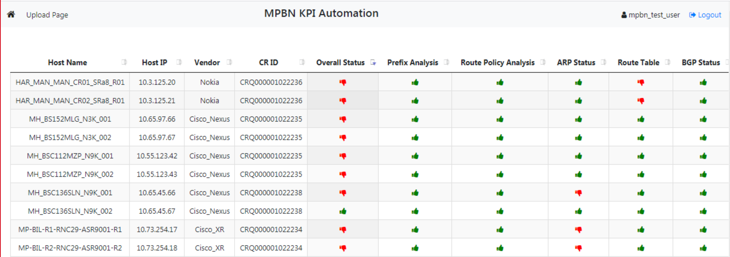
MPBN KPI Automation – Main Dashboard

Slide 4
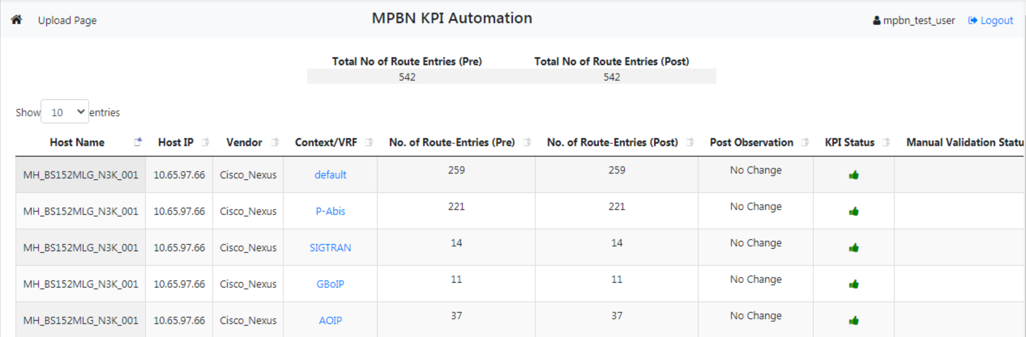
IP Routing Summary – Level 1 Hierarchy

Slide 5
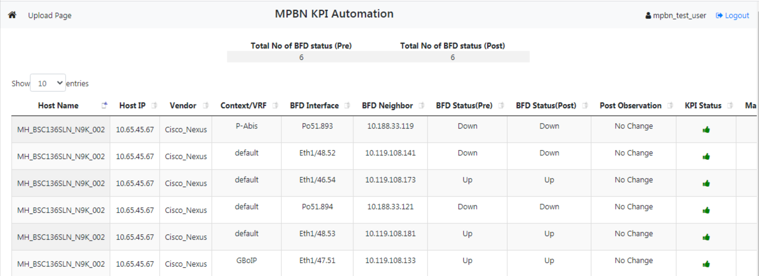
BFD Summary – Level 1 Hierarchy

Slide 6
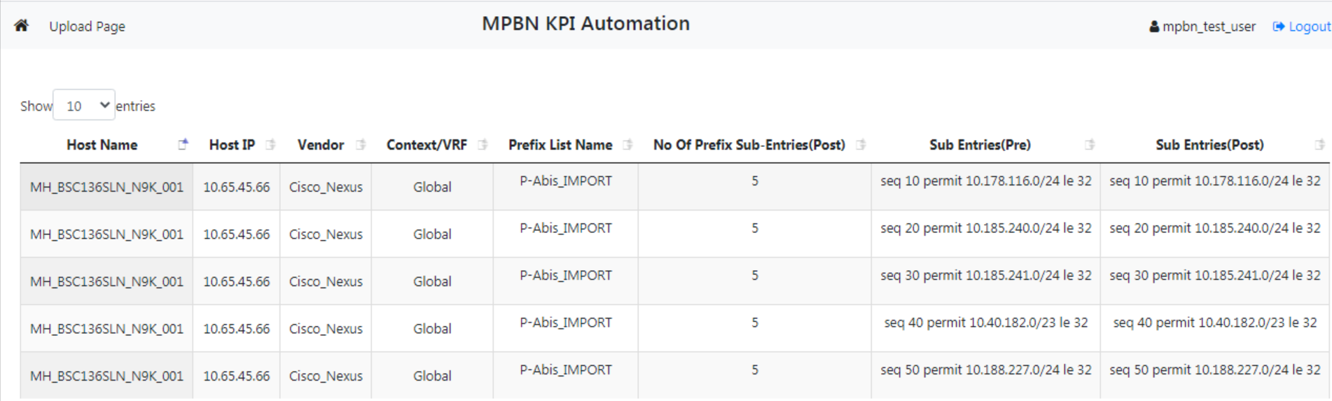
Prefix List Details – Level 2 Hierarchy

Slide 7
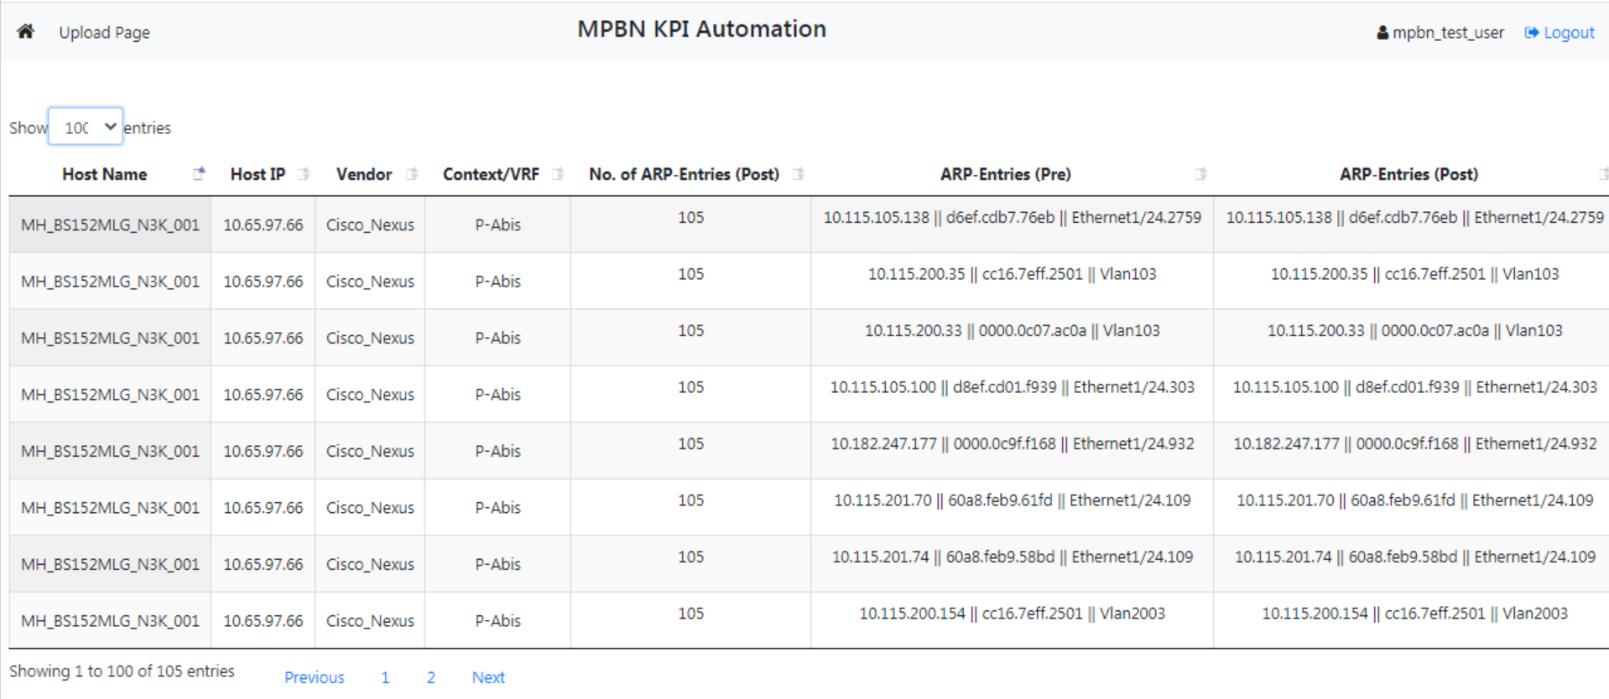
ARP Entry Details – Level 2 Hierarchy

